Slide 1
akka & typesafe console
lujian@19lou.com

Slide 2
Why
Scale up (Concurrency)
Scale out (Remoting)
Fault tolerance
支持： Scala & Java
可扩展，允许只加载需要的包

Slide 3
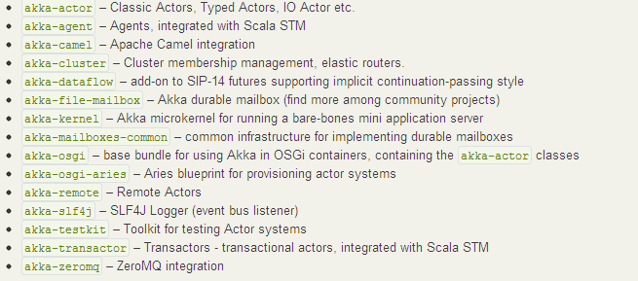
module

Slide 4
Networking
Cluster Specification
Cluster Usage
Remoting
Serialization
I/O
Encoding and decoding binary data
Using TCP
Using UDP
ZeroMQ
Camel

Slide 5
akka
// server
class HelloWorldActor extends Actor {
def receive = ｛
case msg => self.reply(msg)
｝
}
remote.start("localhost", 2552).register(“hello-service”, actorOf[HelloWorldActor])
// client
val actor = remote.actorFor(“hello-service”,"localhost",2552).start
val result = actor !! "Hello“

Slide 6
http://doc.akka.io/docs/akka/2.2.0/scala.html
http://doc.akka.io/docs/akka/snapshot/general/configuration.html

